Slide 1
NAME : AKILN.M REGISTER.NO : 312203228,
asunm161312203228 DEPARTMENT : B.COM ( GENERAL ) COLLEGE ; PRINCE SHRInVENKATESHWARA ARTS AND SCIENCE COLLEGE

Slide 2

Topic :

Slide 3

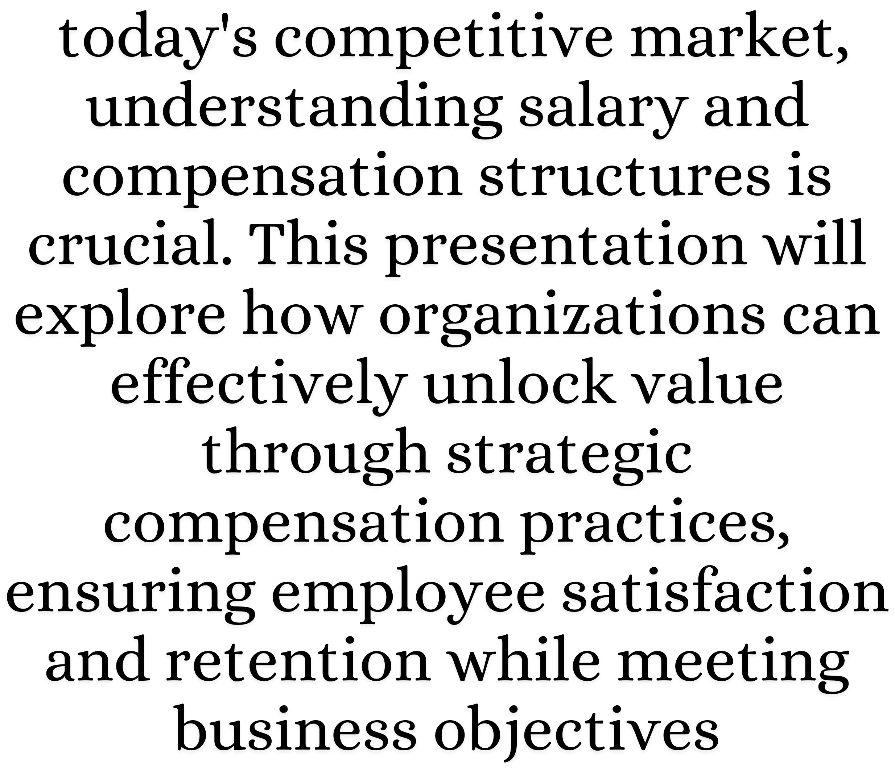


Introduction to Salary Structures

Slide 4


Importance of Compensation Analysis
Analyzing compensation is essential for maintaining equity and fairness within an organization. A well-structured analysis helps identify gaps, enabling companies to adjust salaries and benefits to remain competitive and attract top talent.

Slide 5



Components of Salary Structures
Salary structures typically include base pay, bonuses, and benefits.
Understanding these components allows organizations to design a comprehensive compensation package that meets the needs of employees while aligning with the company’s financial goals.

Slide 6

Strategies for E ective Compensation
Implementing effective compensation strategies involves regular market analysis, employee feedback, and alignment with organizational goals. Companies should prioritize transparency and communication to foster a culture of trust and motivation among employees.

Slide 7


Challenges in Salary Management
Organizations often face challenges such as budget constraints, market fluctuations, and employee expectations. Addressing these challenges requires a proactive approach to salary management, ensuring that compensation remains competitive and fair.

Slide 8

Conclusion
Unlocking value through effective salary and compensation structures is vital for organizational success. By continuously analyzing and adjusting these structures, companies can enhance employee satisfaction, retention, and overall performance in the marketplace.

Slide 9
THANK YOU

